Slide 1
Hough Transforms for Materials Analysis

Slide 2
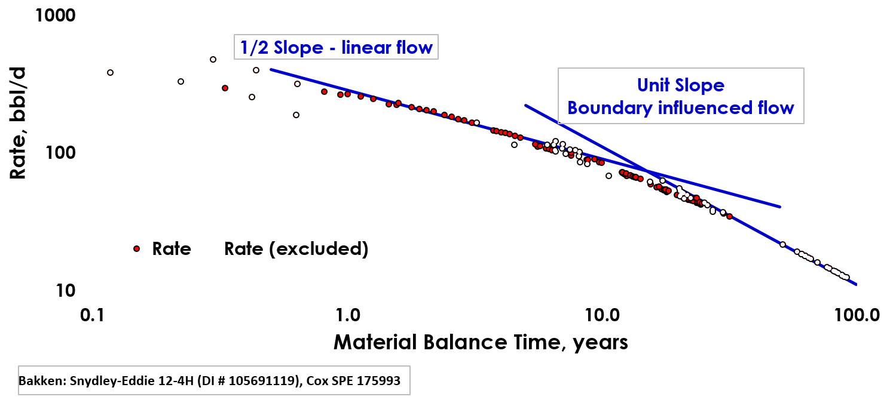
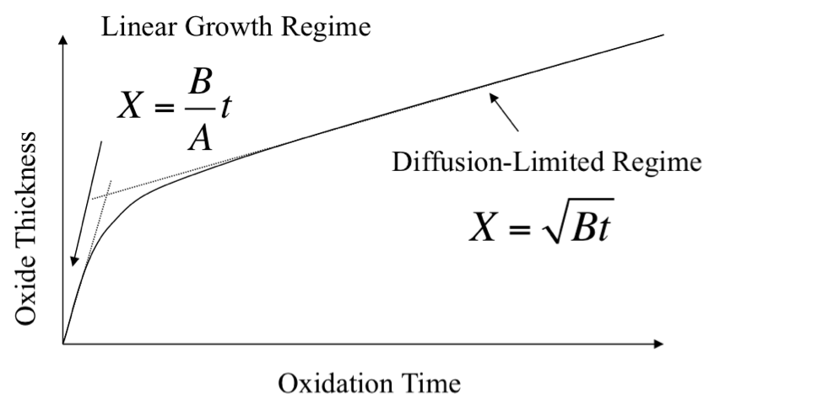
Multiple linear regions can describe… multiple kinetic regimes
Deal, B. E.; A. S. Grove, "General Relationship for the Thermal Oxidation of Silicon". Journal of Applied Physics. 36 n. 12 (1965) 3770–3778
John Lee, Petroleum Reservoir Prediction,
http://energynavigator.com/2016/05/Elements-of-an-Accurate-Production-Forecast,
Accessed 26 Aug 2017
Oxide Growth
Petroleum Reservoir Flow Rates

Slide 3
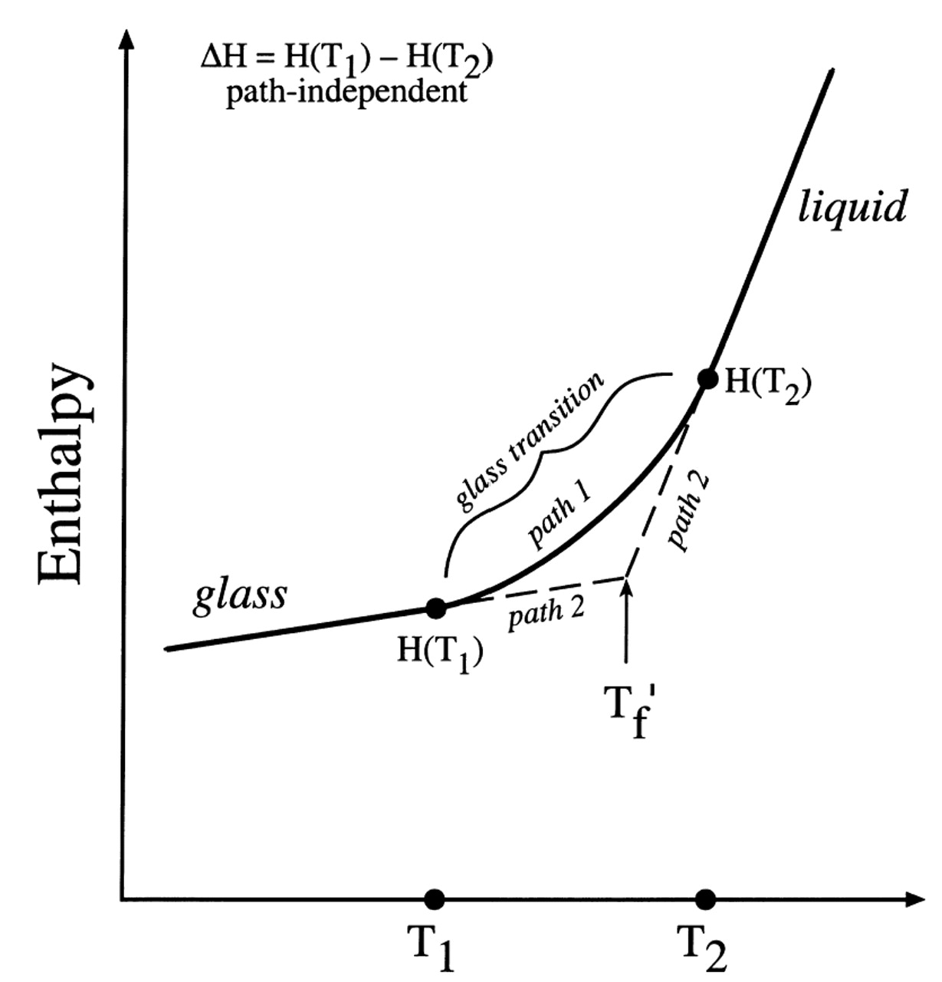
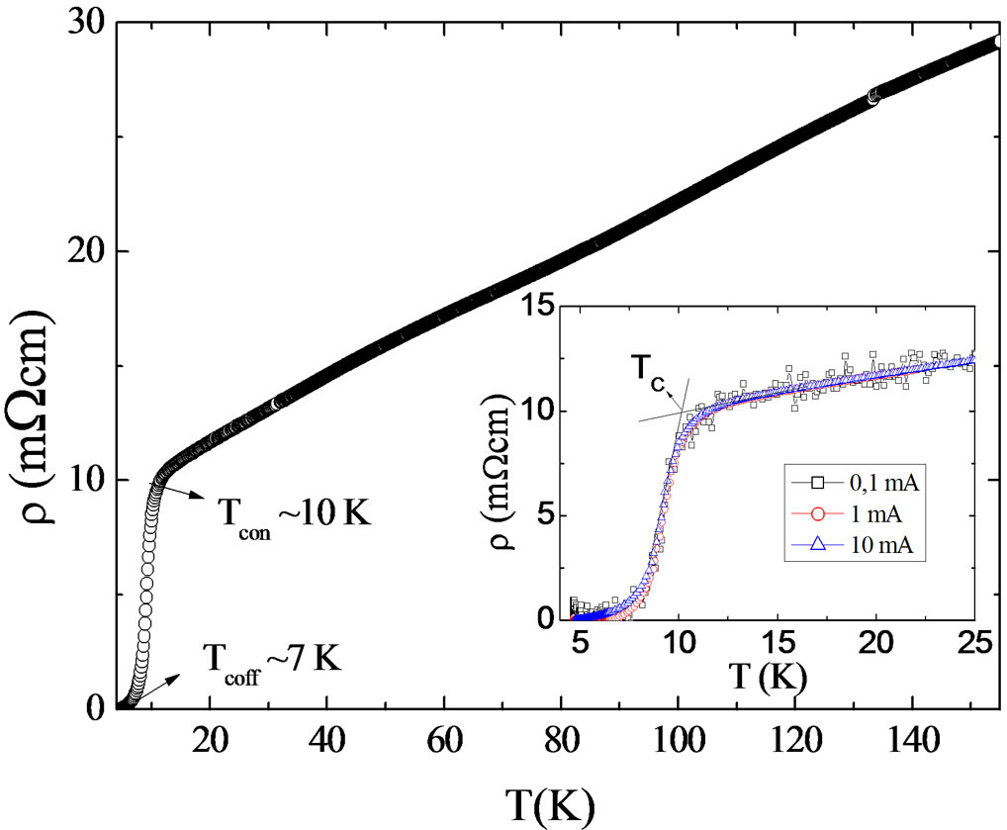
Multiple linear regions can differentiate… property changes in materials
Glass Transition
Superconductivity
Jean A. Tangeman, Rebecca A. Lange, American Mineralogist Nov 2001, 86 n. 11-12 (2001) 1331-1344
A. Bortolozo, A. Gueiros, L. Alves and C. Santos, Materials Sciences and Applications, Vol. 3 No. 9 (2012) pp. 624-627

Slide 4
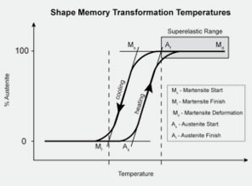
Linear regions are ubiquitous… So what?
Automation
Improves consistency
Improves throughput
Improves traceability
Maximizes information extraction
Consistency improves interpretability,
Throughput improves contextual analysis.
Traceability improves accuracy.
Information extraction maximizes efficiency.
M_{s} at linear insection
A_{f} at linear insection
And, of course, SMAs
M_{f} at linear insection
uncredited
A_{s} at linear insection

Slide 5
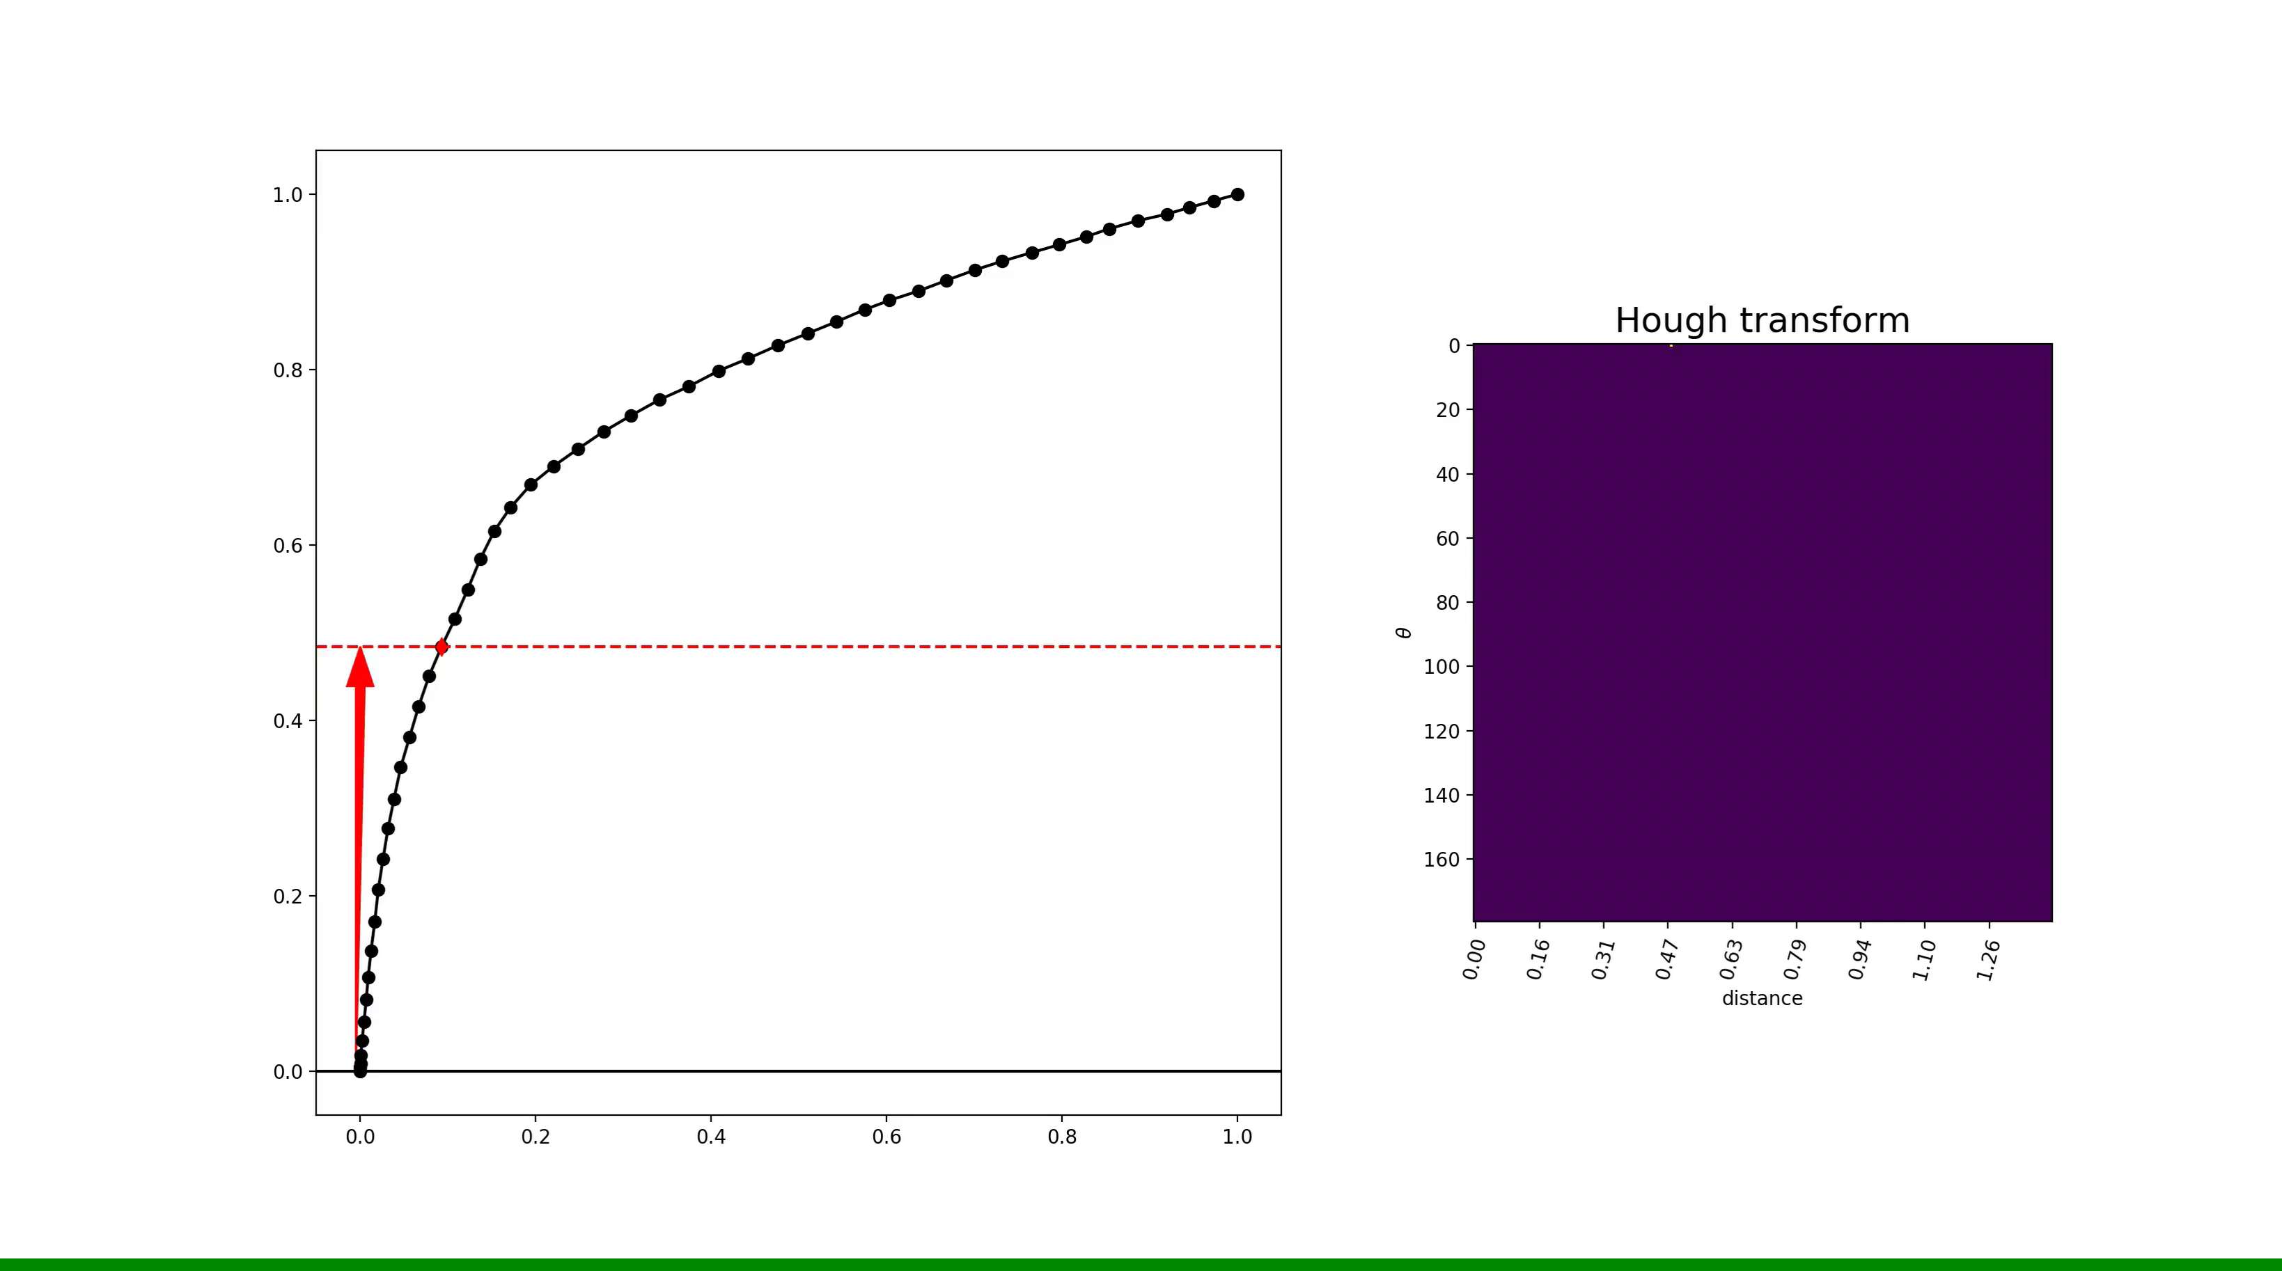
Hough transforms are central to automating these analyses
A Hough transform is a multidimensional histogram.
Provides the probability that a shape is present.
Identifies the location of the shape.

Slide 6
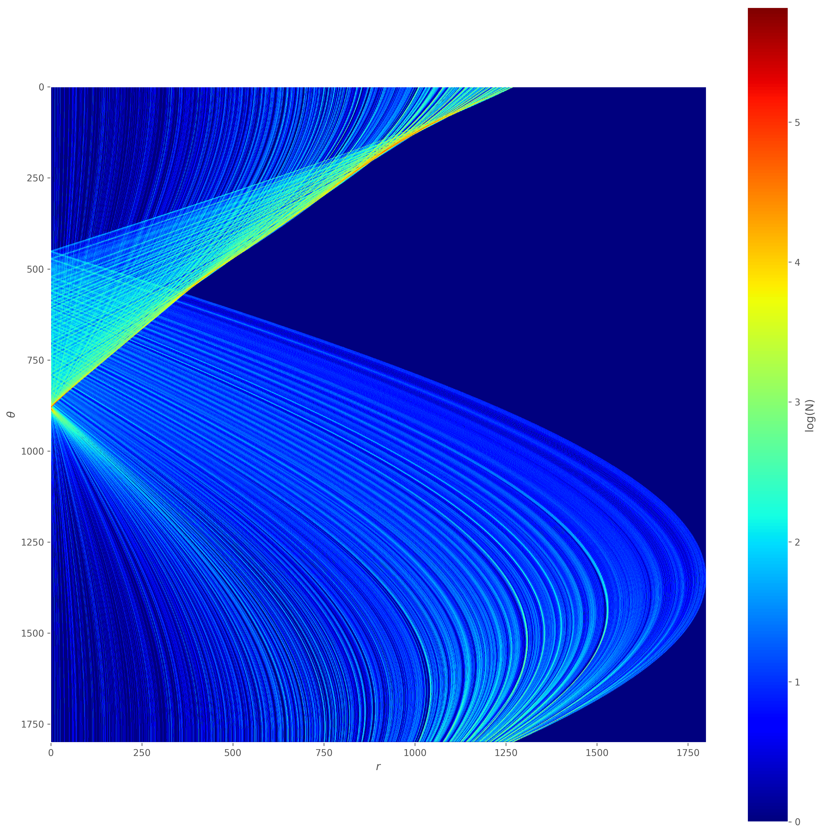
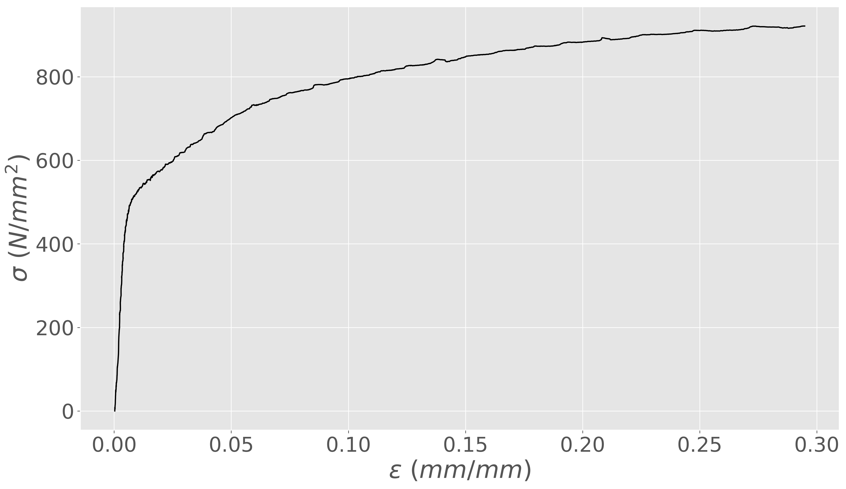
Hough transform identifies linear features

Slide 7
Gotchas, nuances and tricks-of-the-trade
Hough transforms should be performed on data of equivalent spatial extent.
Normalize X and Y.
Calculate the transform.
Identify important features (of scaled data).
”Unnormalize” features back to original spatial extents.
Partition the transform to limit the search for relevant features.
Do you know if the line will be nearly vertical? Horizontal? Etc.?
Resample the transform to improve feature contrast

Slide 8
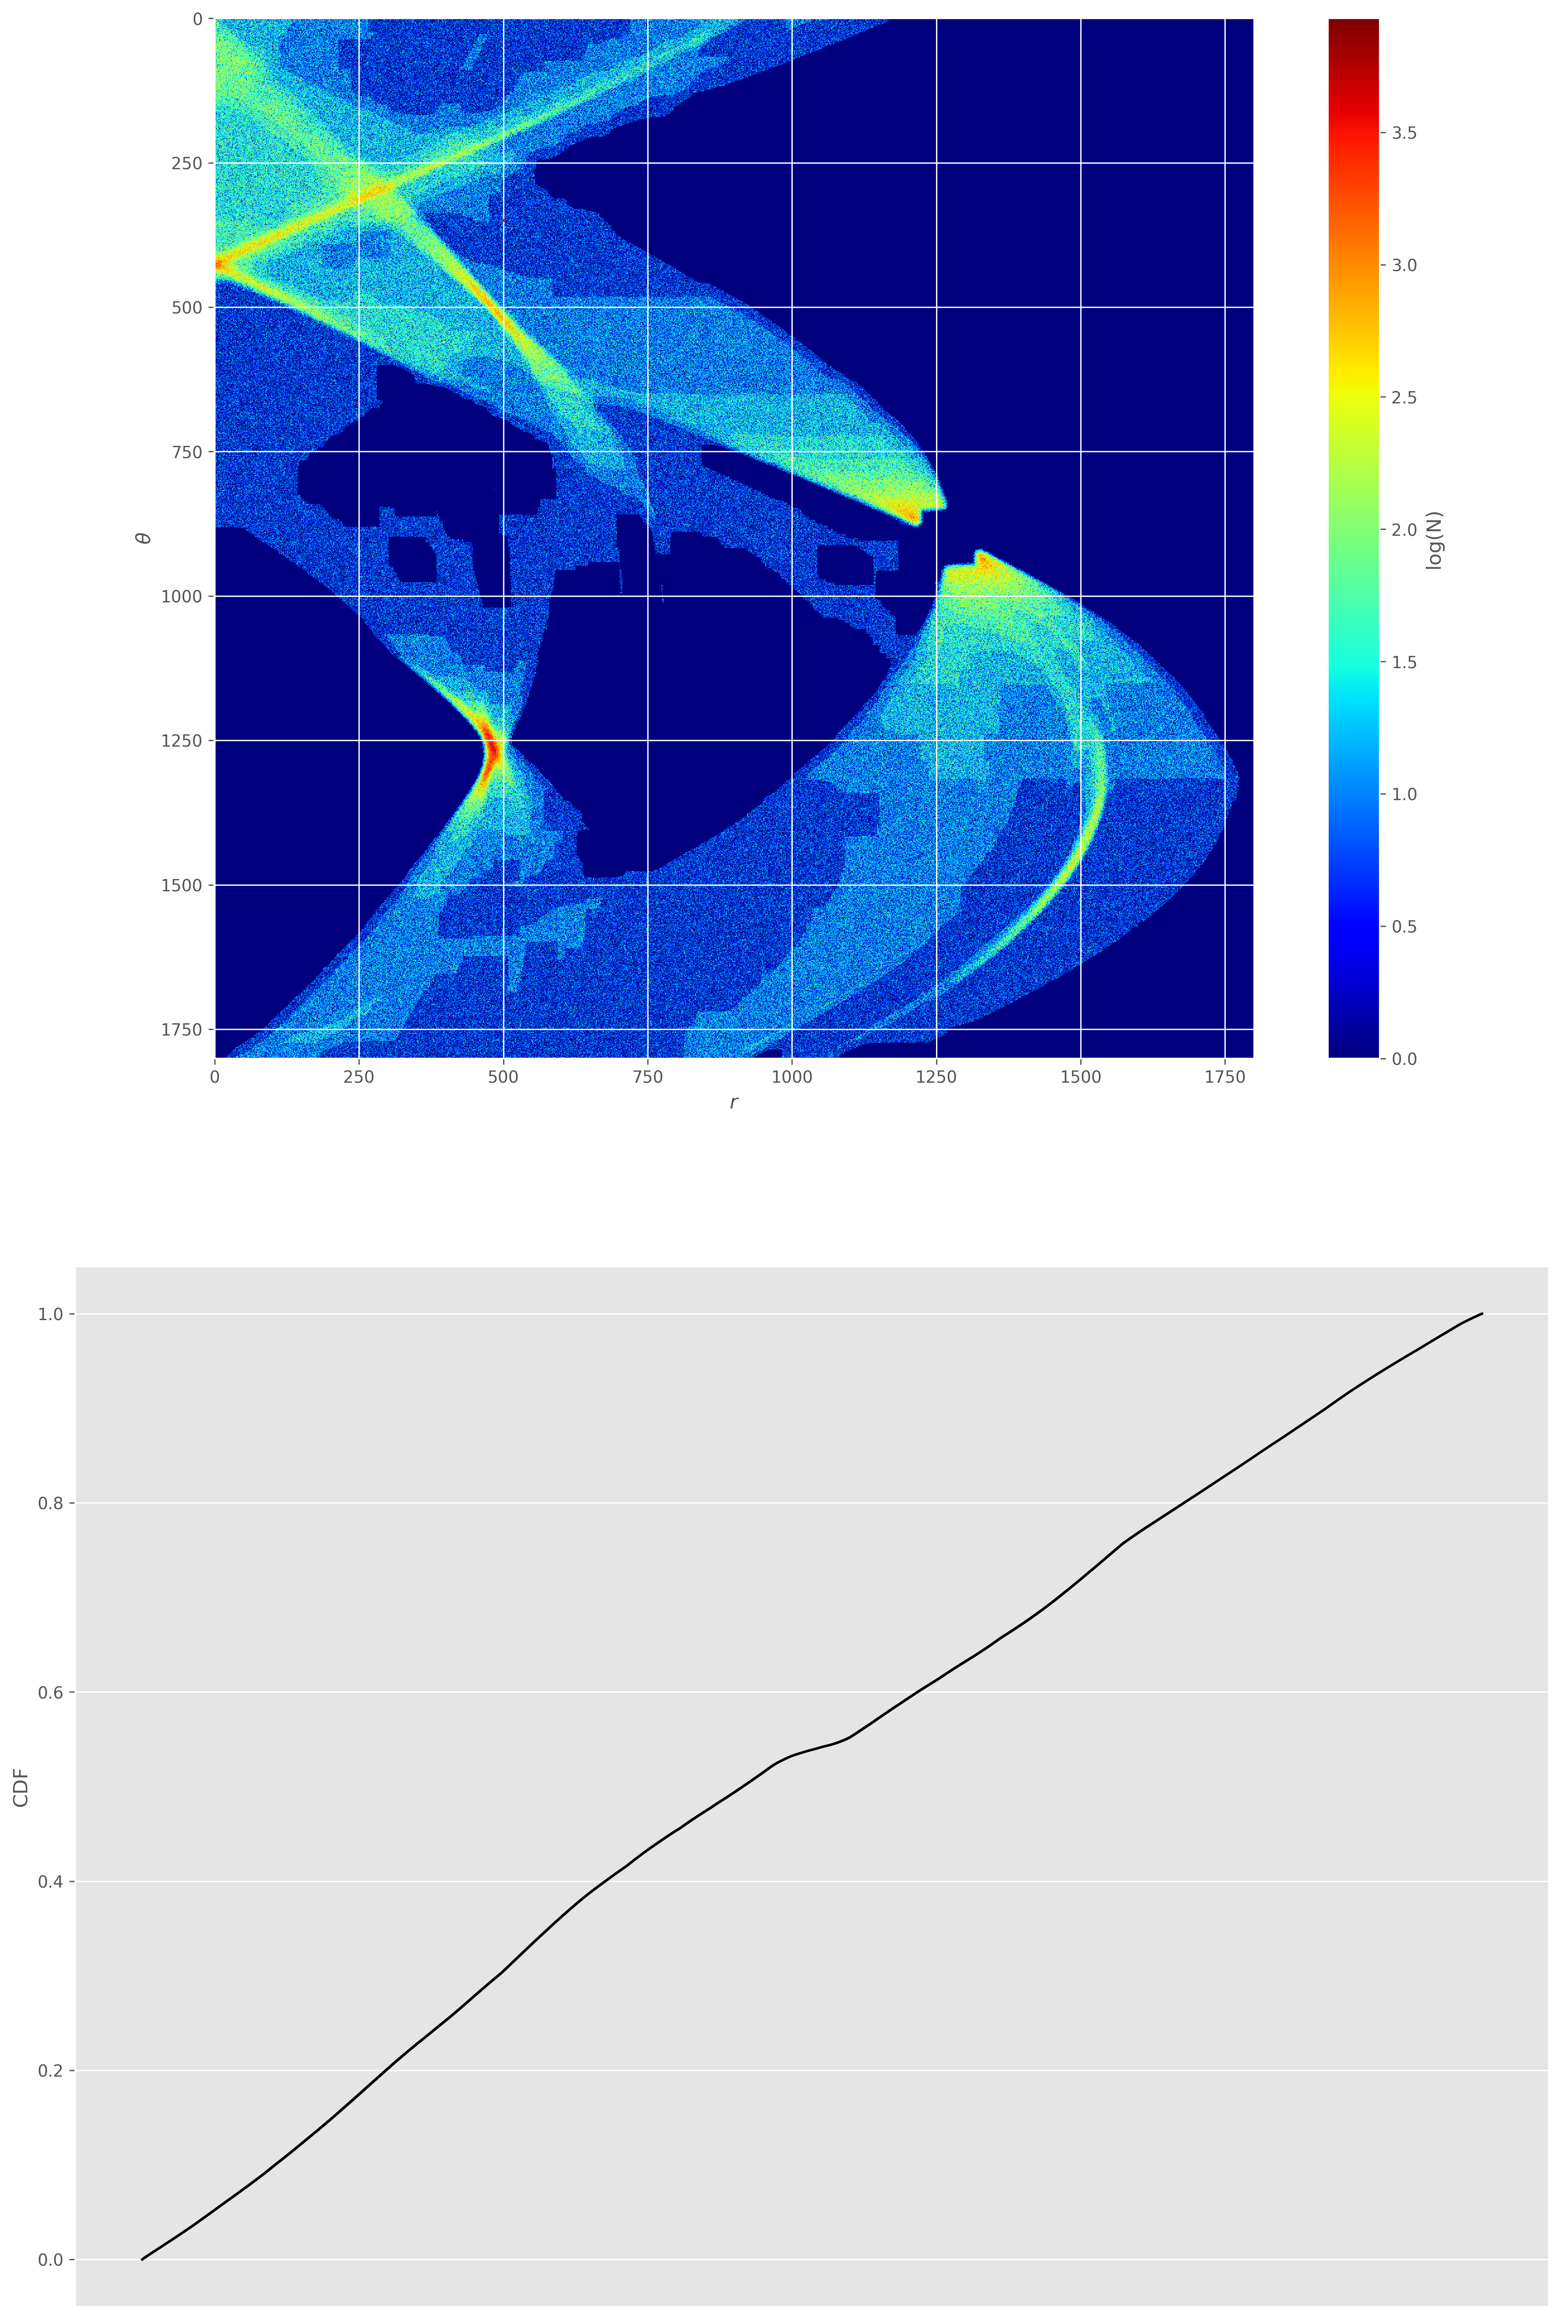
Resampling the image exaggerates high frequency events
416
#3
Generate a continuous distribution function (CDF) of the image (bottom frame).
CDF abscissa in range [0, 1]
CDF ordinate is corresponding pixel location.
Use a uniform RNG to pick a value in [0, 1] to find the corresponding image index.
Increment that position in the accumulator (top frame).
Repeat steps 2 and 3.
Sample as many times as the total intensity in the image.
137
#1
#2
0.55
(416, 137)

Slide 9
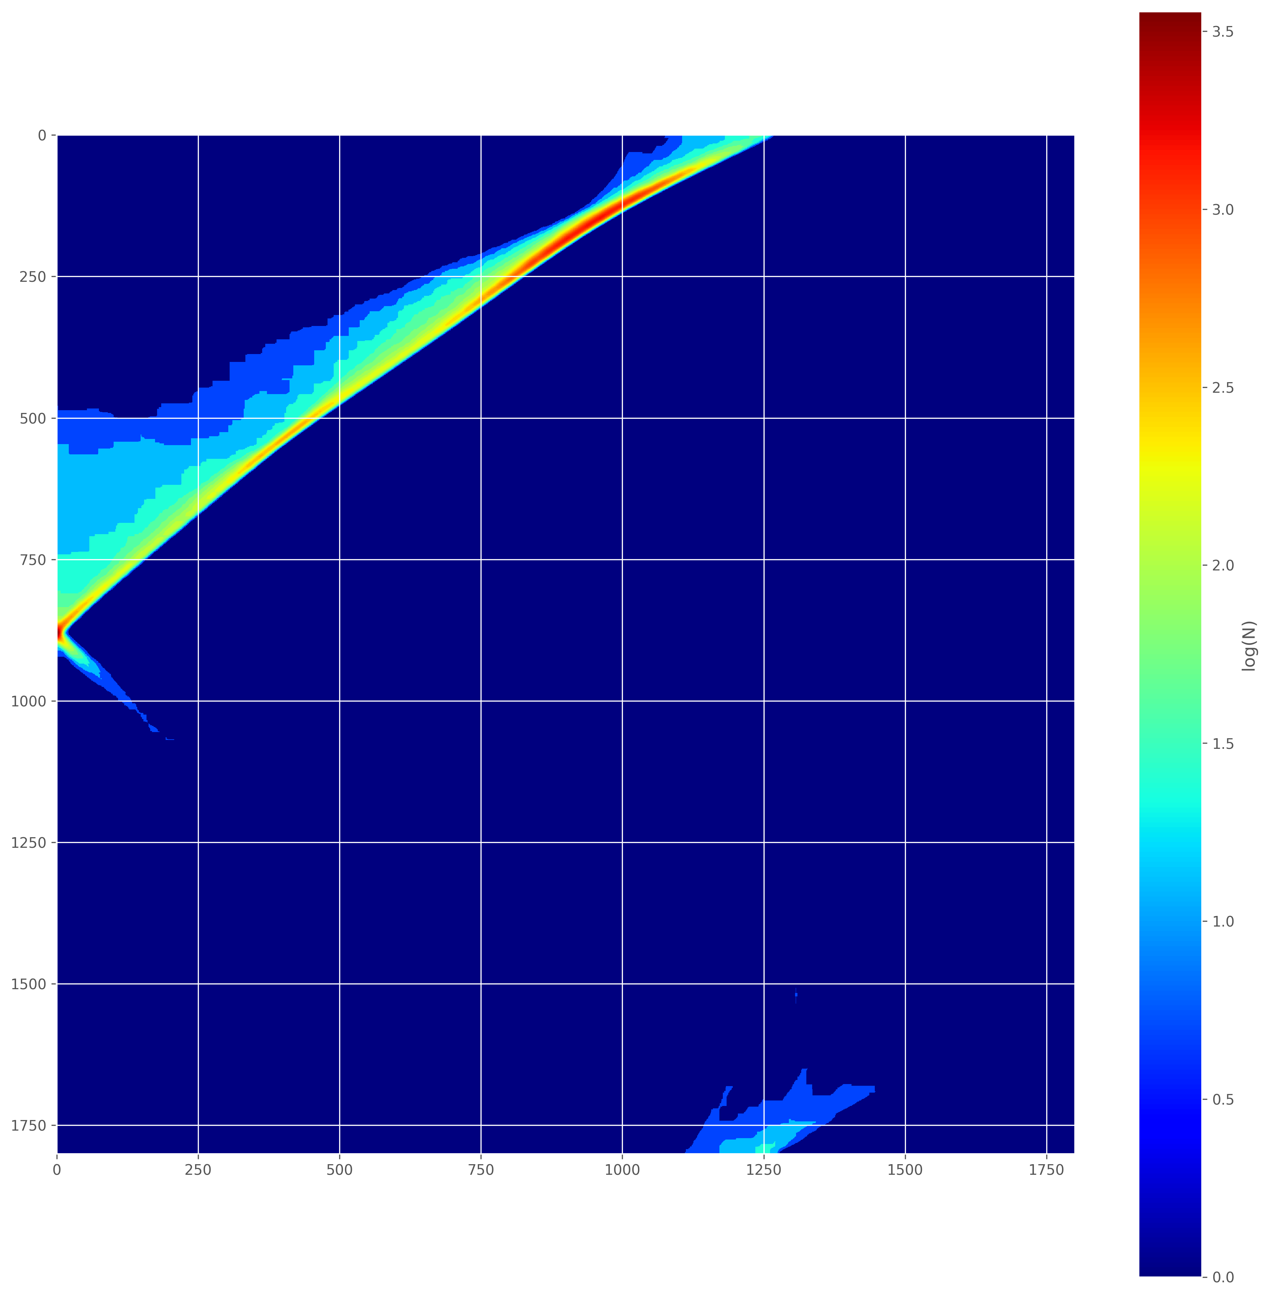
Resampling improves feature contrast
Peak location is much more clear

Slide 10
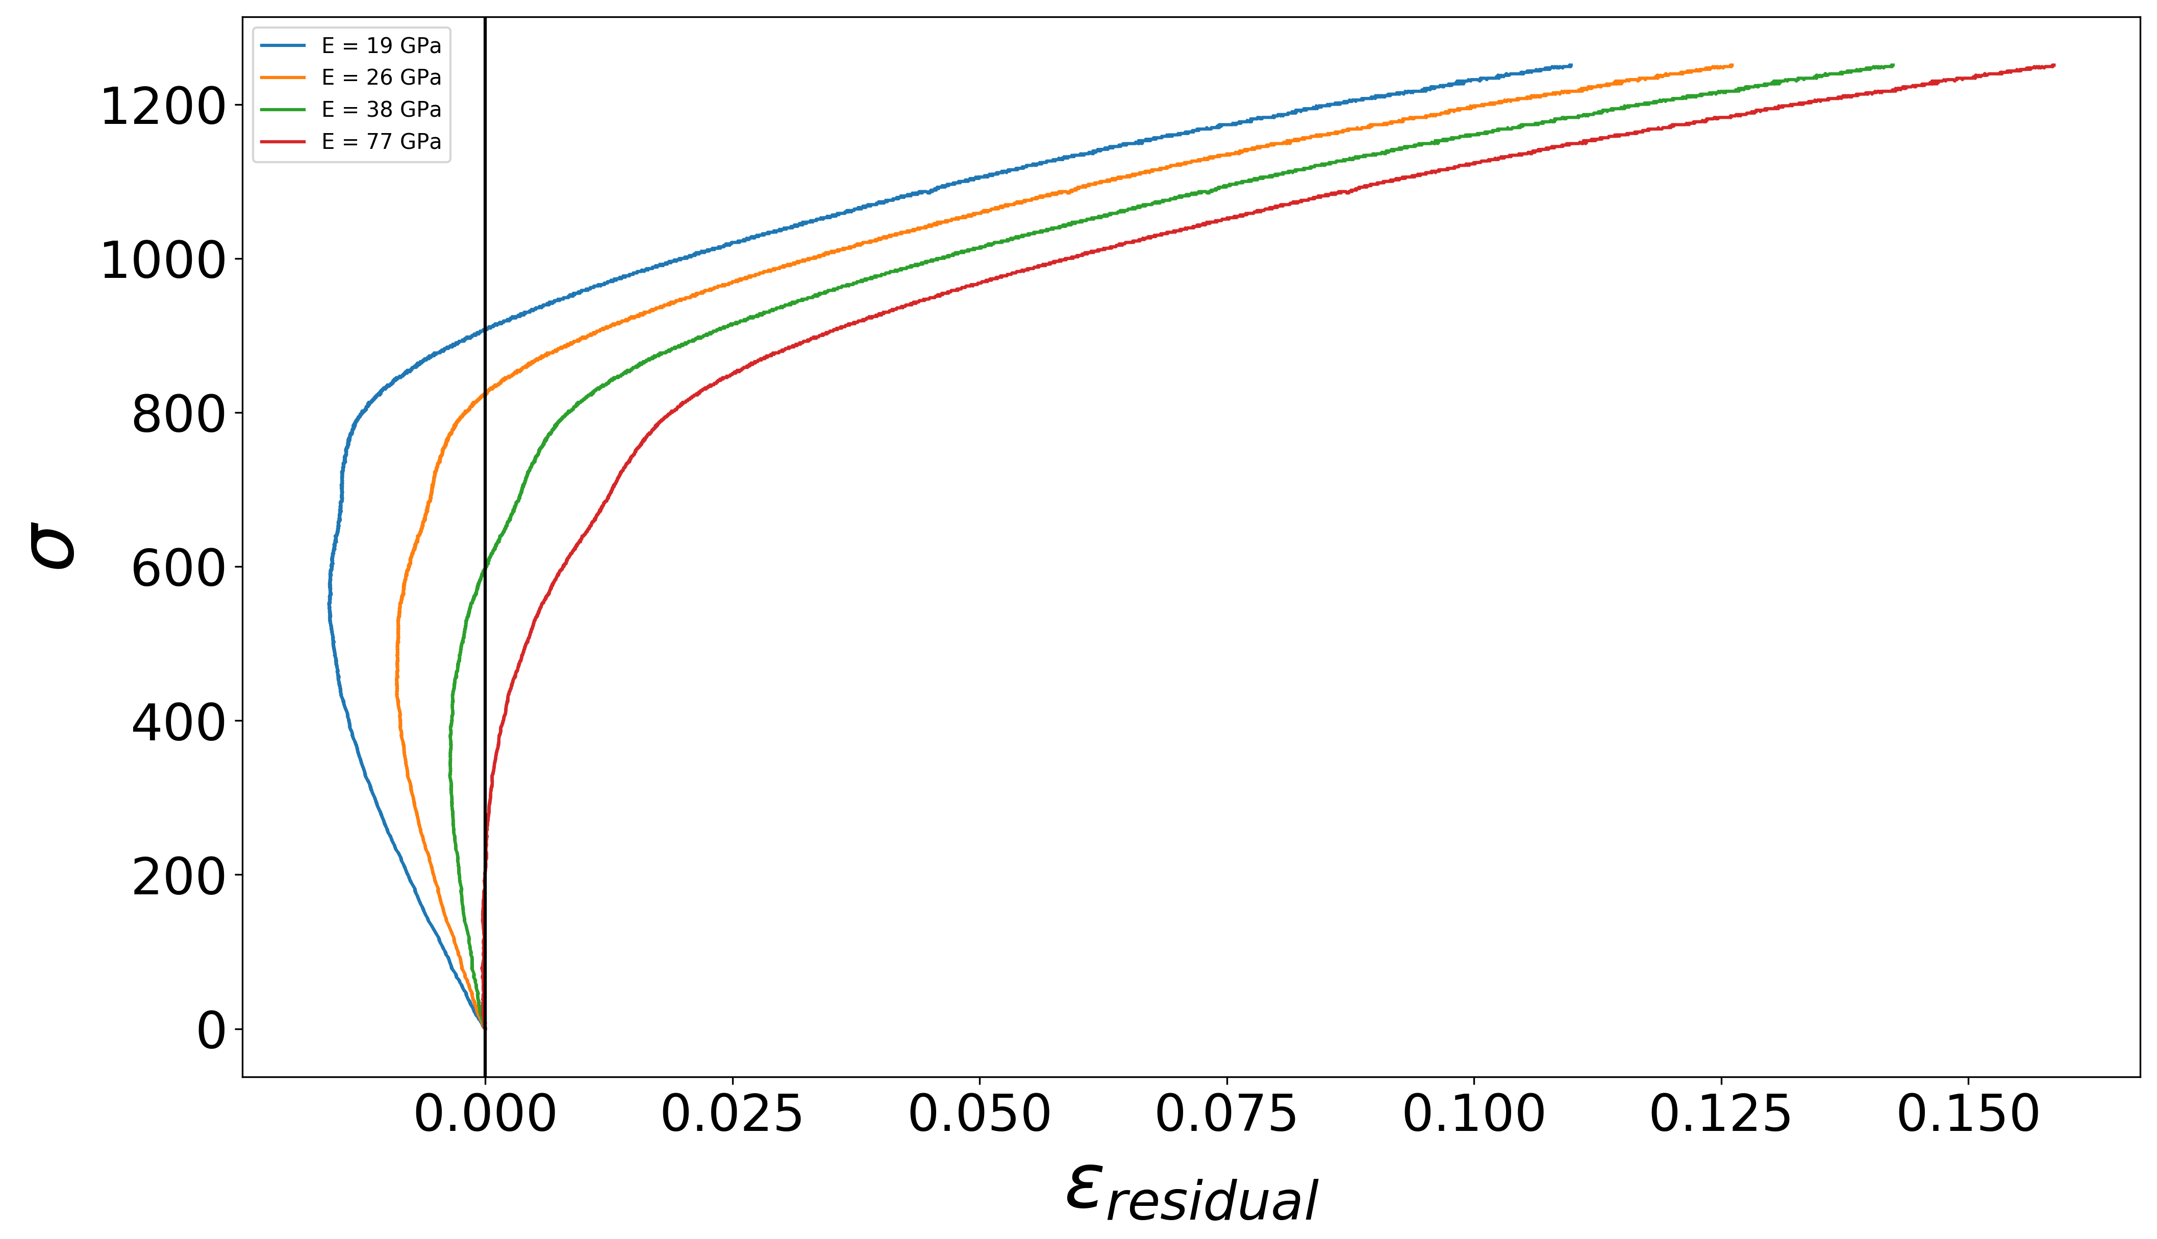
Case study: ASTM E111
Find approximate elastic modulus using Hough transform.
Use stress vs. residual strain to select points and minimize covariance of the fit.
Defined in ASTM standard
Keep these points

Slide 11
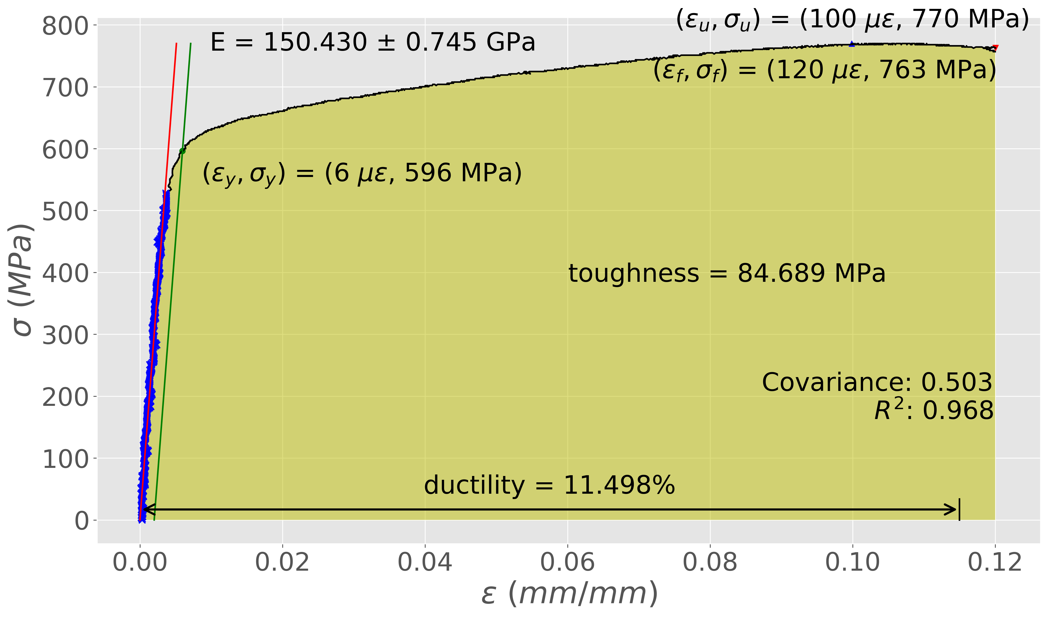
Squeezing all information out of every test
Elastic modulus
(with error)
Ultimate strength
Fracture strength
Yield strength
Robust to
Noisy data
Toughness
Ductility
Fit quality
ASTM E111

Slide 12
Where can we go from here?
Hough transforms can also be used to find other shapes, most notably circles.
High throughput analysis of stress-strain data allows us to make decisions based on engineering values, without the barrier of first finding and processing the mechanical test data.
Questions?

